Slide 1
Reproducible Science and Github (....and YOU!)

Slide 2
What is Reproducible Science?
Open and accessible scientific process, so others can repeat and replicate
Transparency in data collection, processing, analysis
Publicly available processing/analysis methods
Transparent communication of results
Benefits of Reproducible Science
Transparency in the scientific process to everyone, even the public
Ease of replication and extension of your work by others (greater collaboration + peer review in the scientific community)
Easier for you to re-run your own analyses as time passes!

Slide 3

Notes:
What is version control?

Slide 4
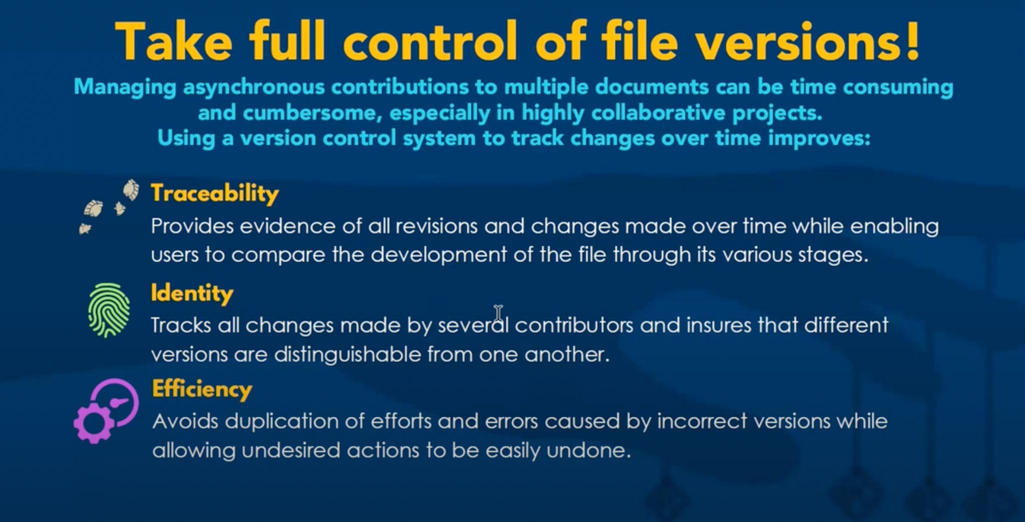

Slide 5
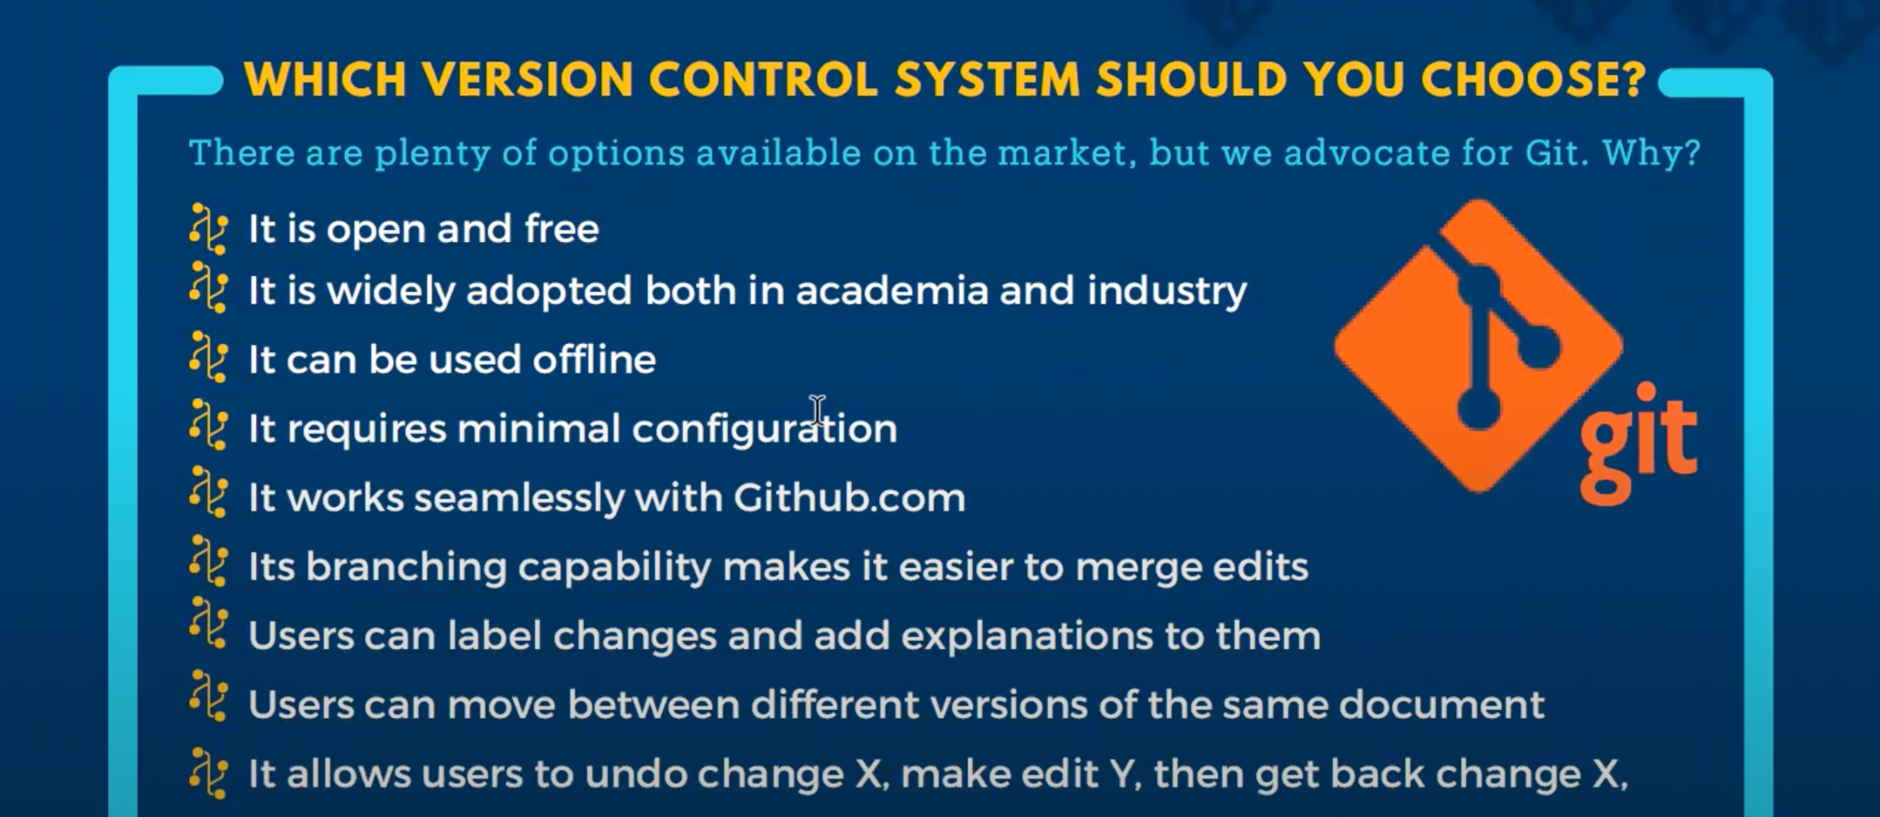

Slide 6
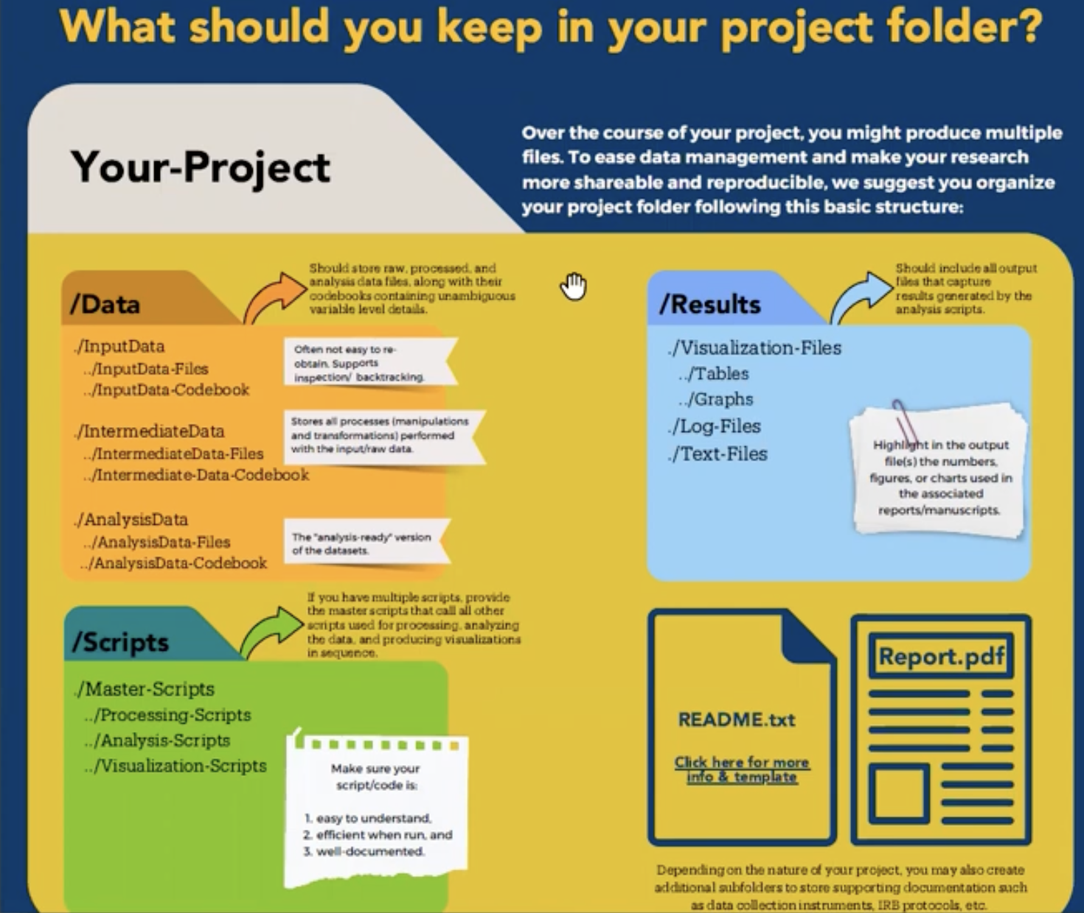
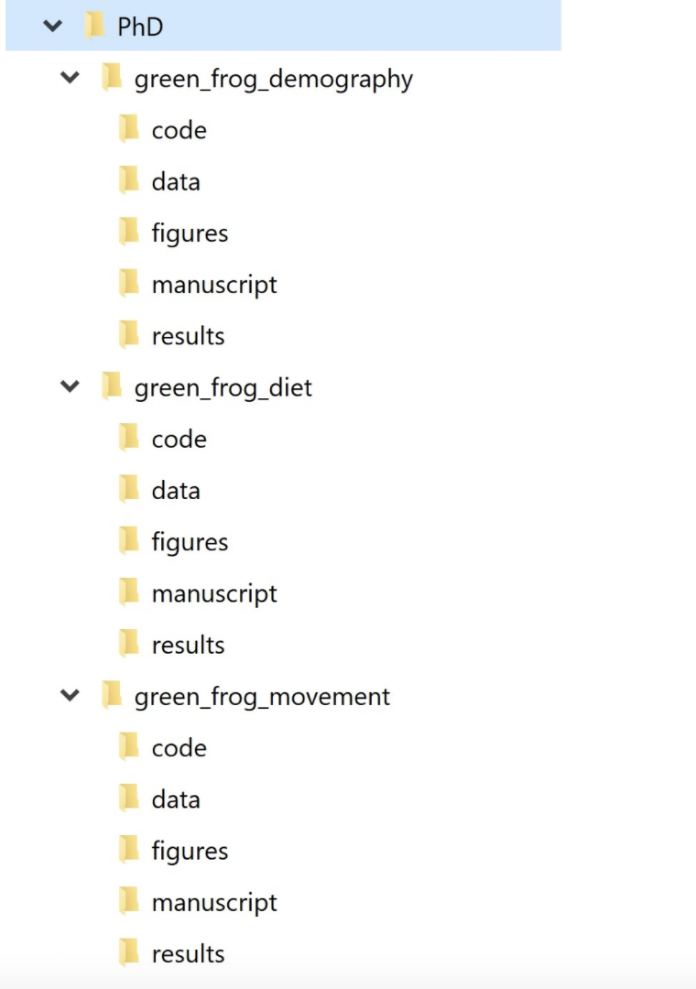

Slide 7
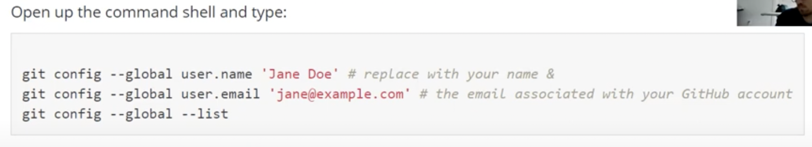
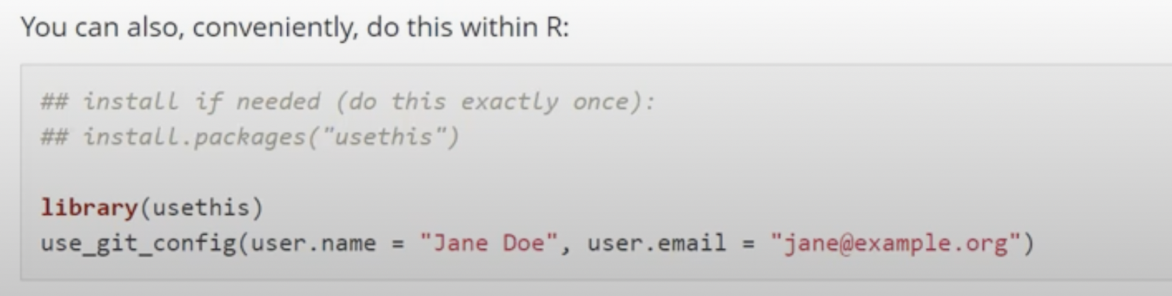
Steps to use Github
Create a git account
Install git
Introduce your computer to git

Slide 8
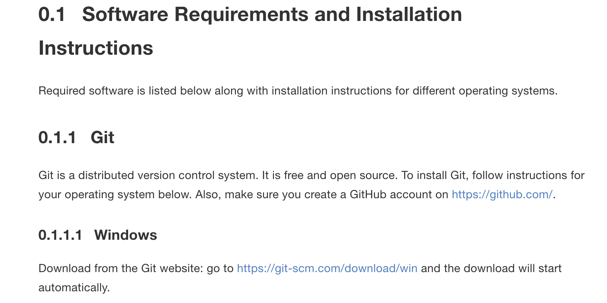
Git Installation: Windows

Slide 9
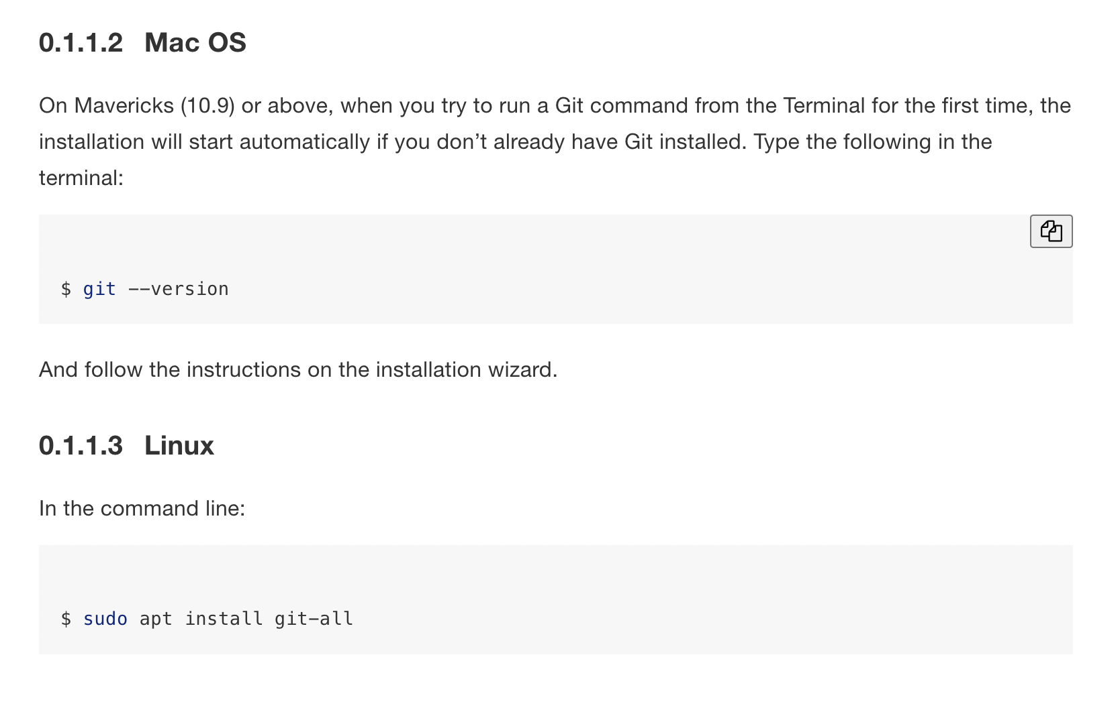
Git Installation: Mac & Linux

Slide 10
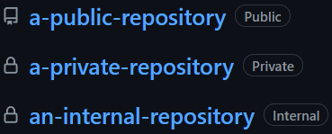
Public vs Private Repositories

Slide 11
Using Github with Rstudio - Let’s try it!
Create a repository in git (with readme and gitignore)
Clone repository in Rstudio
Create new R script
Push new additions to github (“Git” tab, Stage, Commit)
Pull changes (ALWAYS PULL BEFORE MAKING CHANGES!)

